Slide 1
BLG 433E COMPUTER COMMUNICATIONS: WIRESHARK TUTORIAL
Instructor: Prof. Sema F. OKTUĞ
Teaching Assistant: Müge EREL ÖZÇEVİK
FALL 2017

Slide 2
OUTLINE
Introduction
What is Wireshark?
Building and Installing Wireshark
Traffic Monitoring
Capturing Packets
Analyzing Packets
Filtering Packets etc.
Notes:
Wireshark is one of the network monitoring tool

Slide 3
INTRODUCTION What is Wireshark?
Network packet analyzer [1]
Capture network packets
Display that packet data as detailed as possible
Some examples:
Network administrators use it to troubleshoot network problems
Network security engineers use it to examine security problems
Developers use it to debug protocol implementations
People use it to learn network protocol internals
[1] Wireshark User Guide
Notes:
These are some examples people use Wireshark for.

Slide 4
INTRODUCTION What is Wireshark?
Wireshark is not:
An intrusion detection system
Manipulate things on the networks,
It willl only “measure” things from it
It does not send packets on the network or do other active things
Notes:
It will not warn you when someone does strange things on your network that he/she isn’t allowed to do.
However, if strange things happen, Wireshark might help you figure out what is really going on.

Slide 5
INTRODUCTION Building and Installation
Microsoft Windows
UNIX/Linux
https://www.wireshark.org/ download.html.
$ tar xaf wireshark-2.4.5.tar.xz
$ cd wireshark-2.4.5
$ ./configure
$ make
$ make install

Slide 6
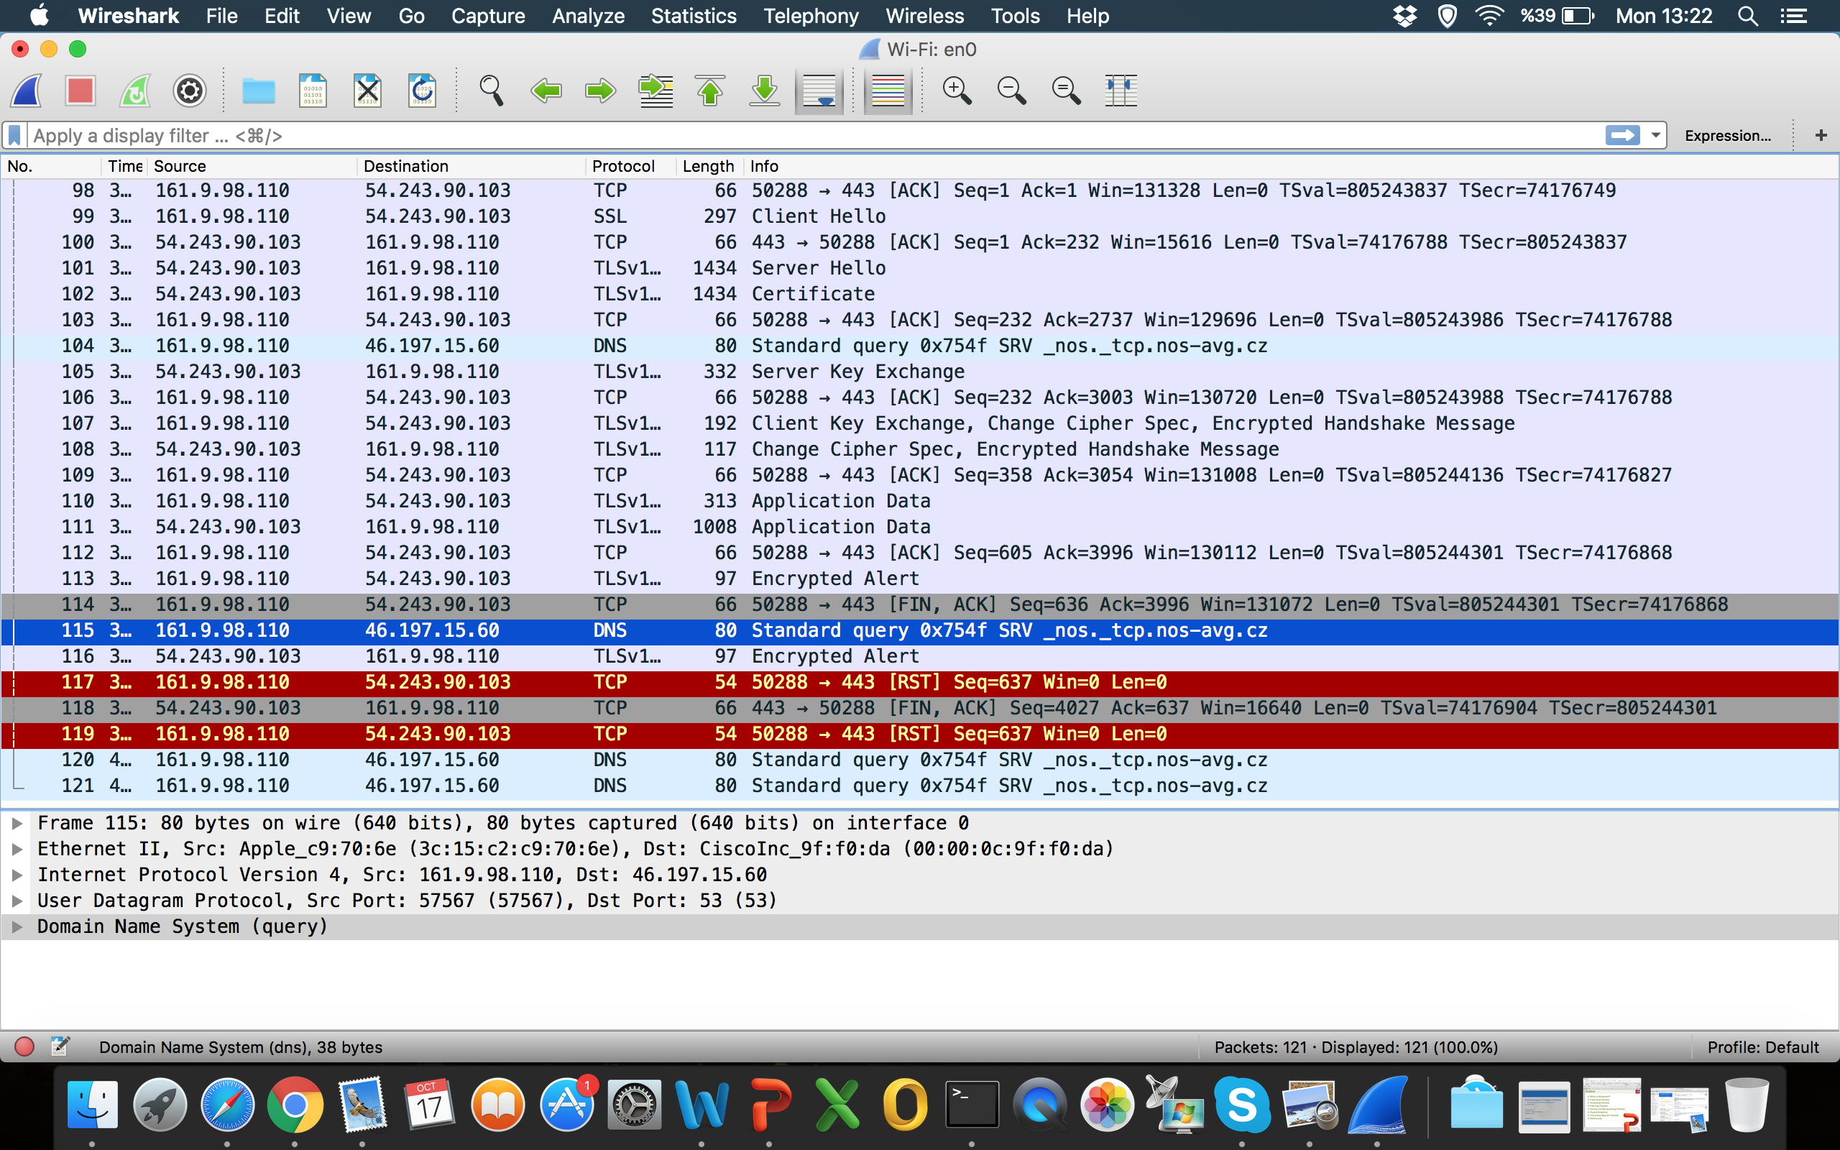
TRAFFIC MONITORING Capturing Packets
Notes:
Menu
Main toolbar
Filter toolbar
Packet list pane
Packet details pane
Status bar

Slide 7
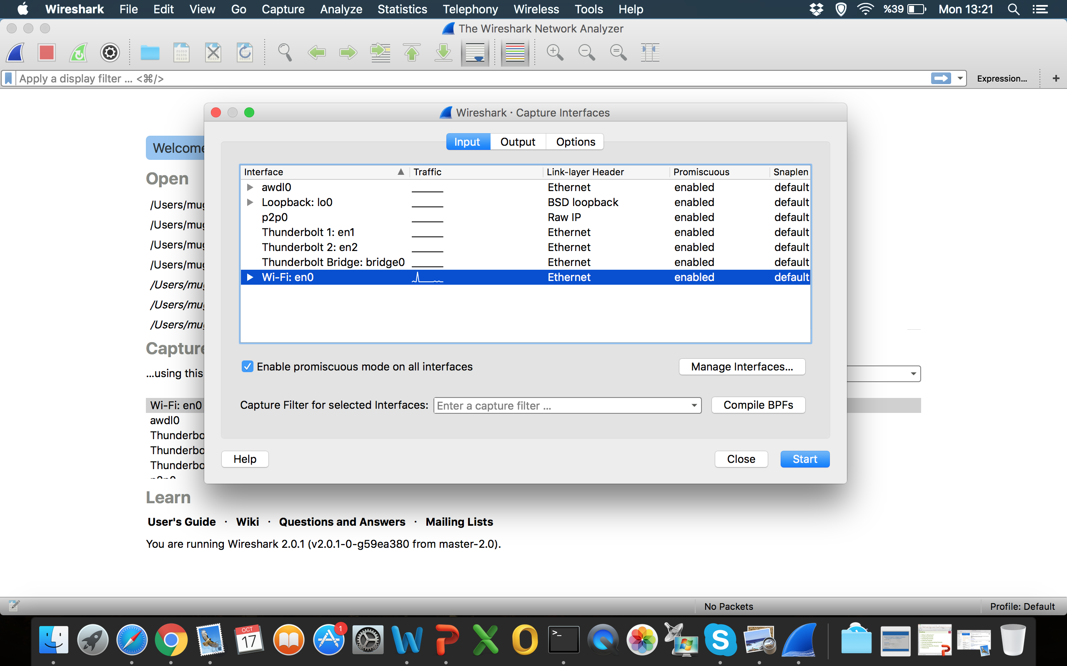
TRAFFIC MONITORING Capturing Packets
Notes:
Capture Interfaces
Capture options
Open Captured files (.pcap file)

Slide 8
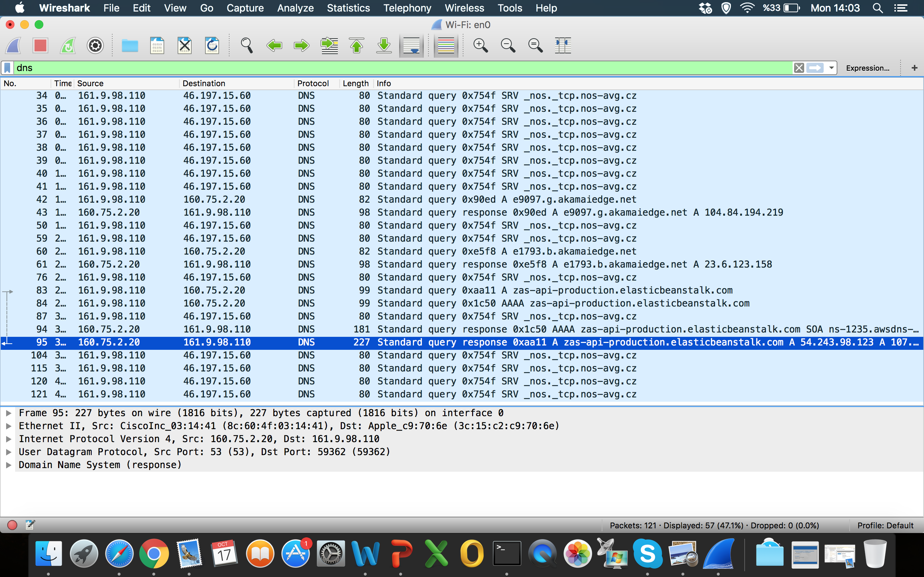
TRAFFIC MONITORING Filtering Packets
Notes:
Dns filtering

Slide 9
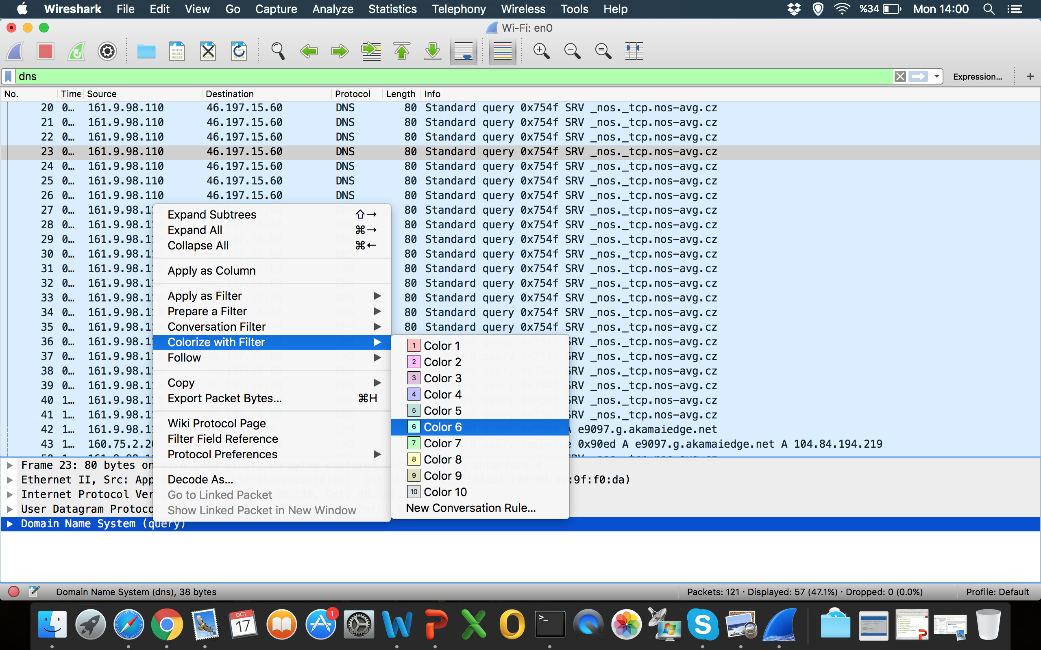
TRAFFIC MONITORING Analyzing Packets
Notes:
Pop up menu of packet list pane –> Coloring

Slide 10
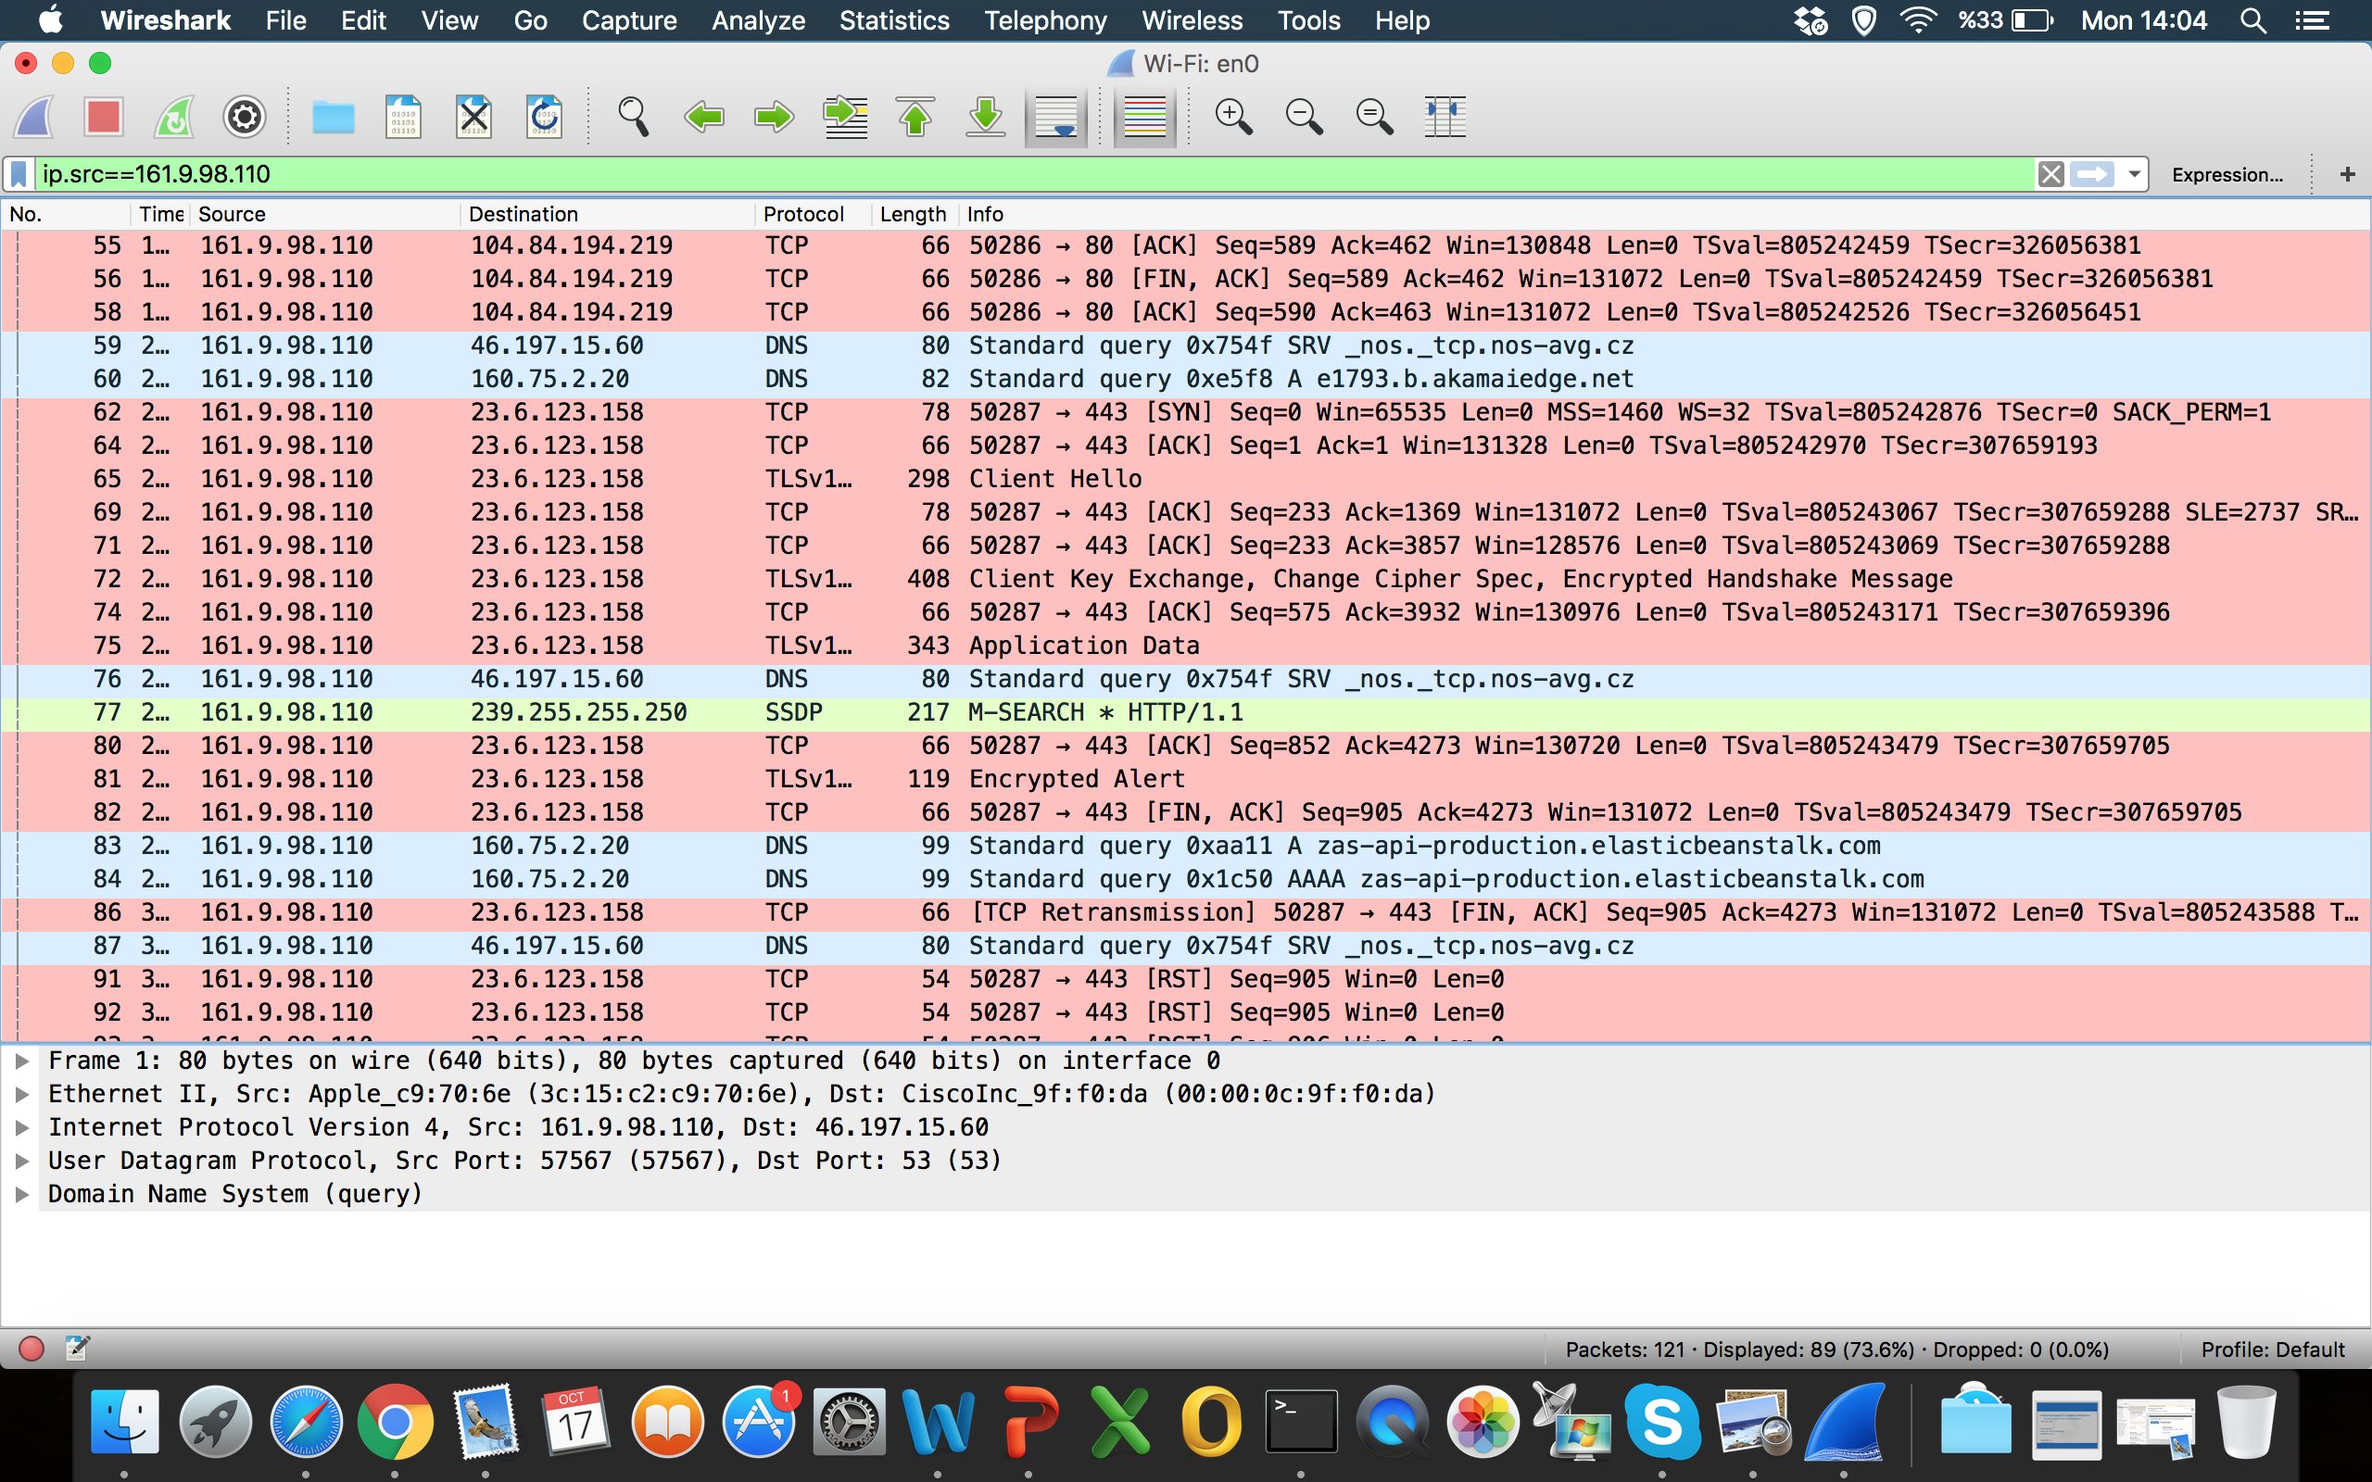
TRAFFIC MONITORING Filtering Packets
Notes:
Ip.src== filtering

Slide 11
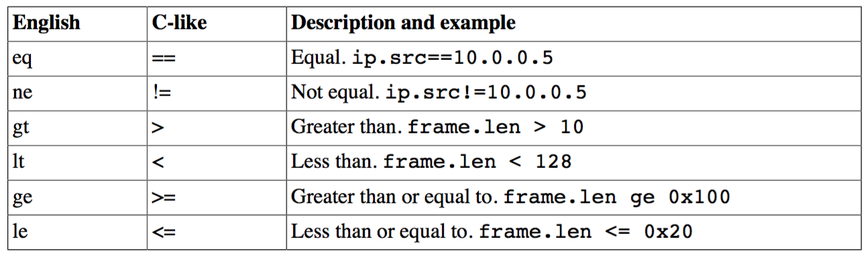
TRAFFIC MONITORING Filtering Packets
* Taken from Wireshark User Guide

Slide 12
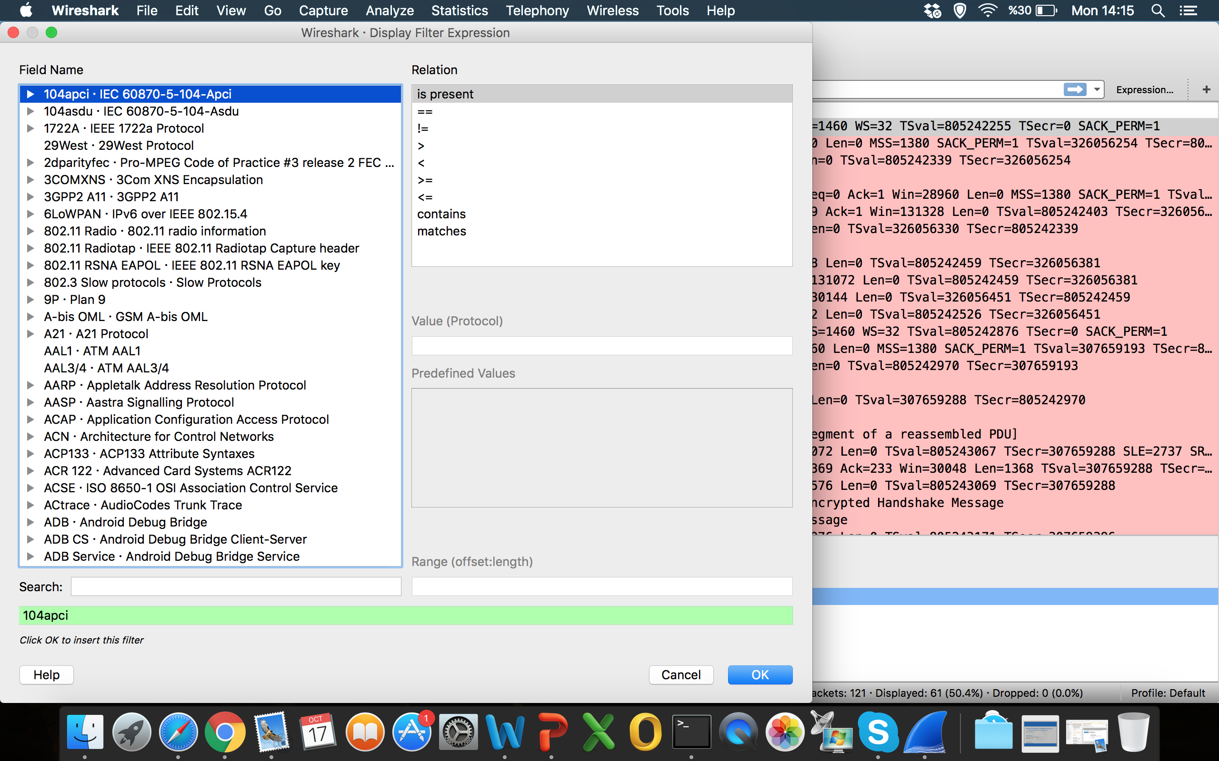
TRAFFIC MONITORING Filtering Packets
Notes:
Filter expressions

Slide 13
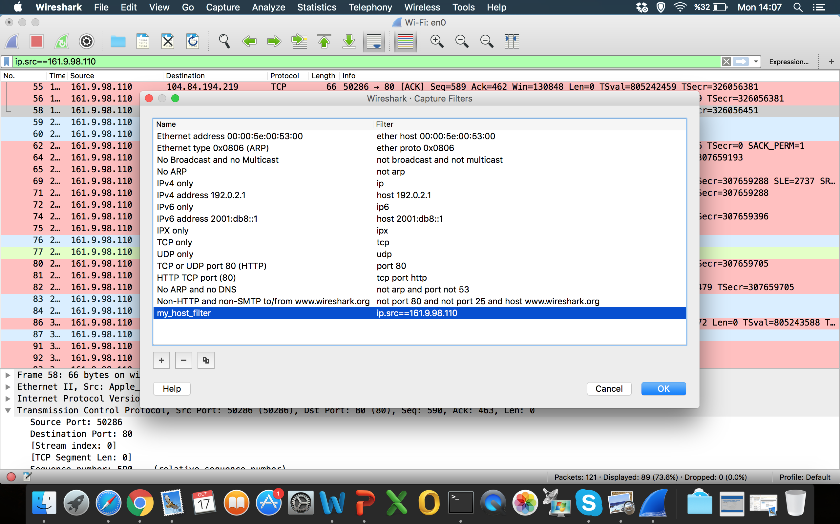
TRAFFIC MONITORING Filtering Packets
Notes:
Saving Filter

Slide 14
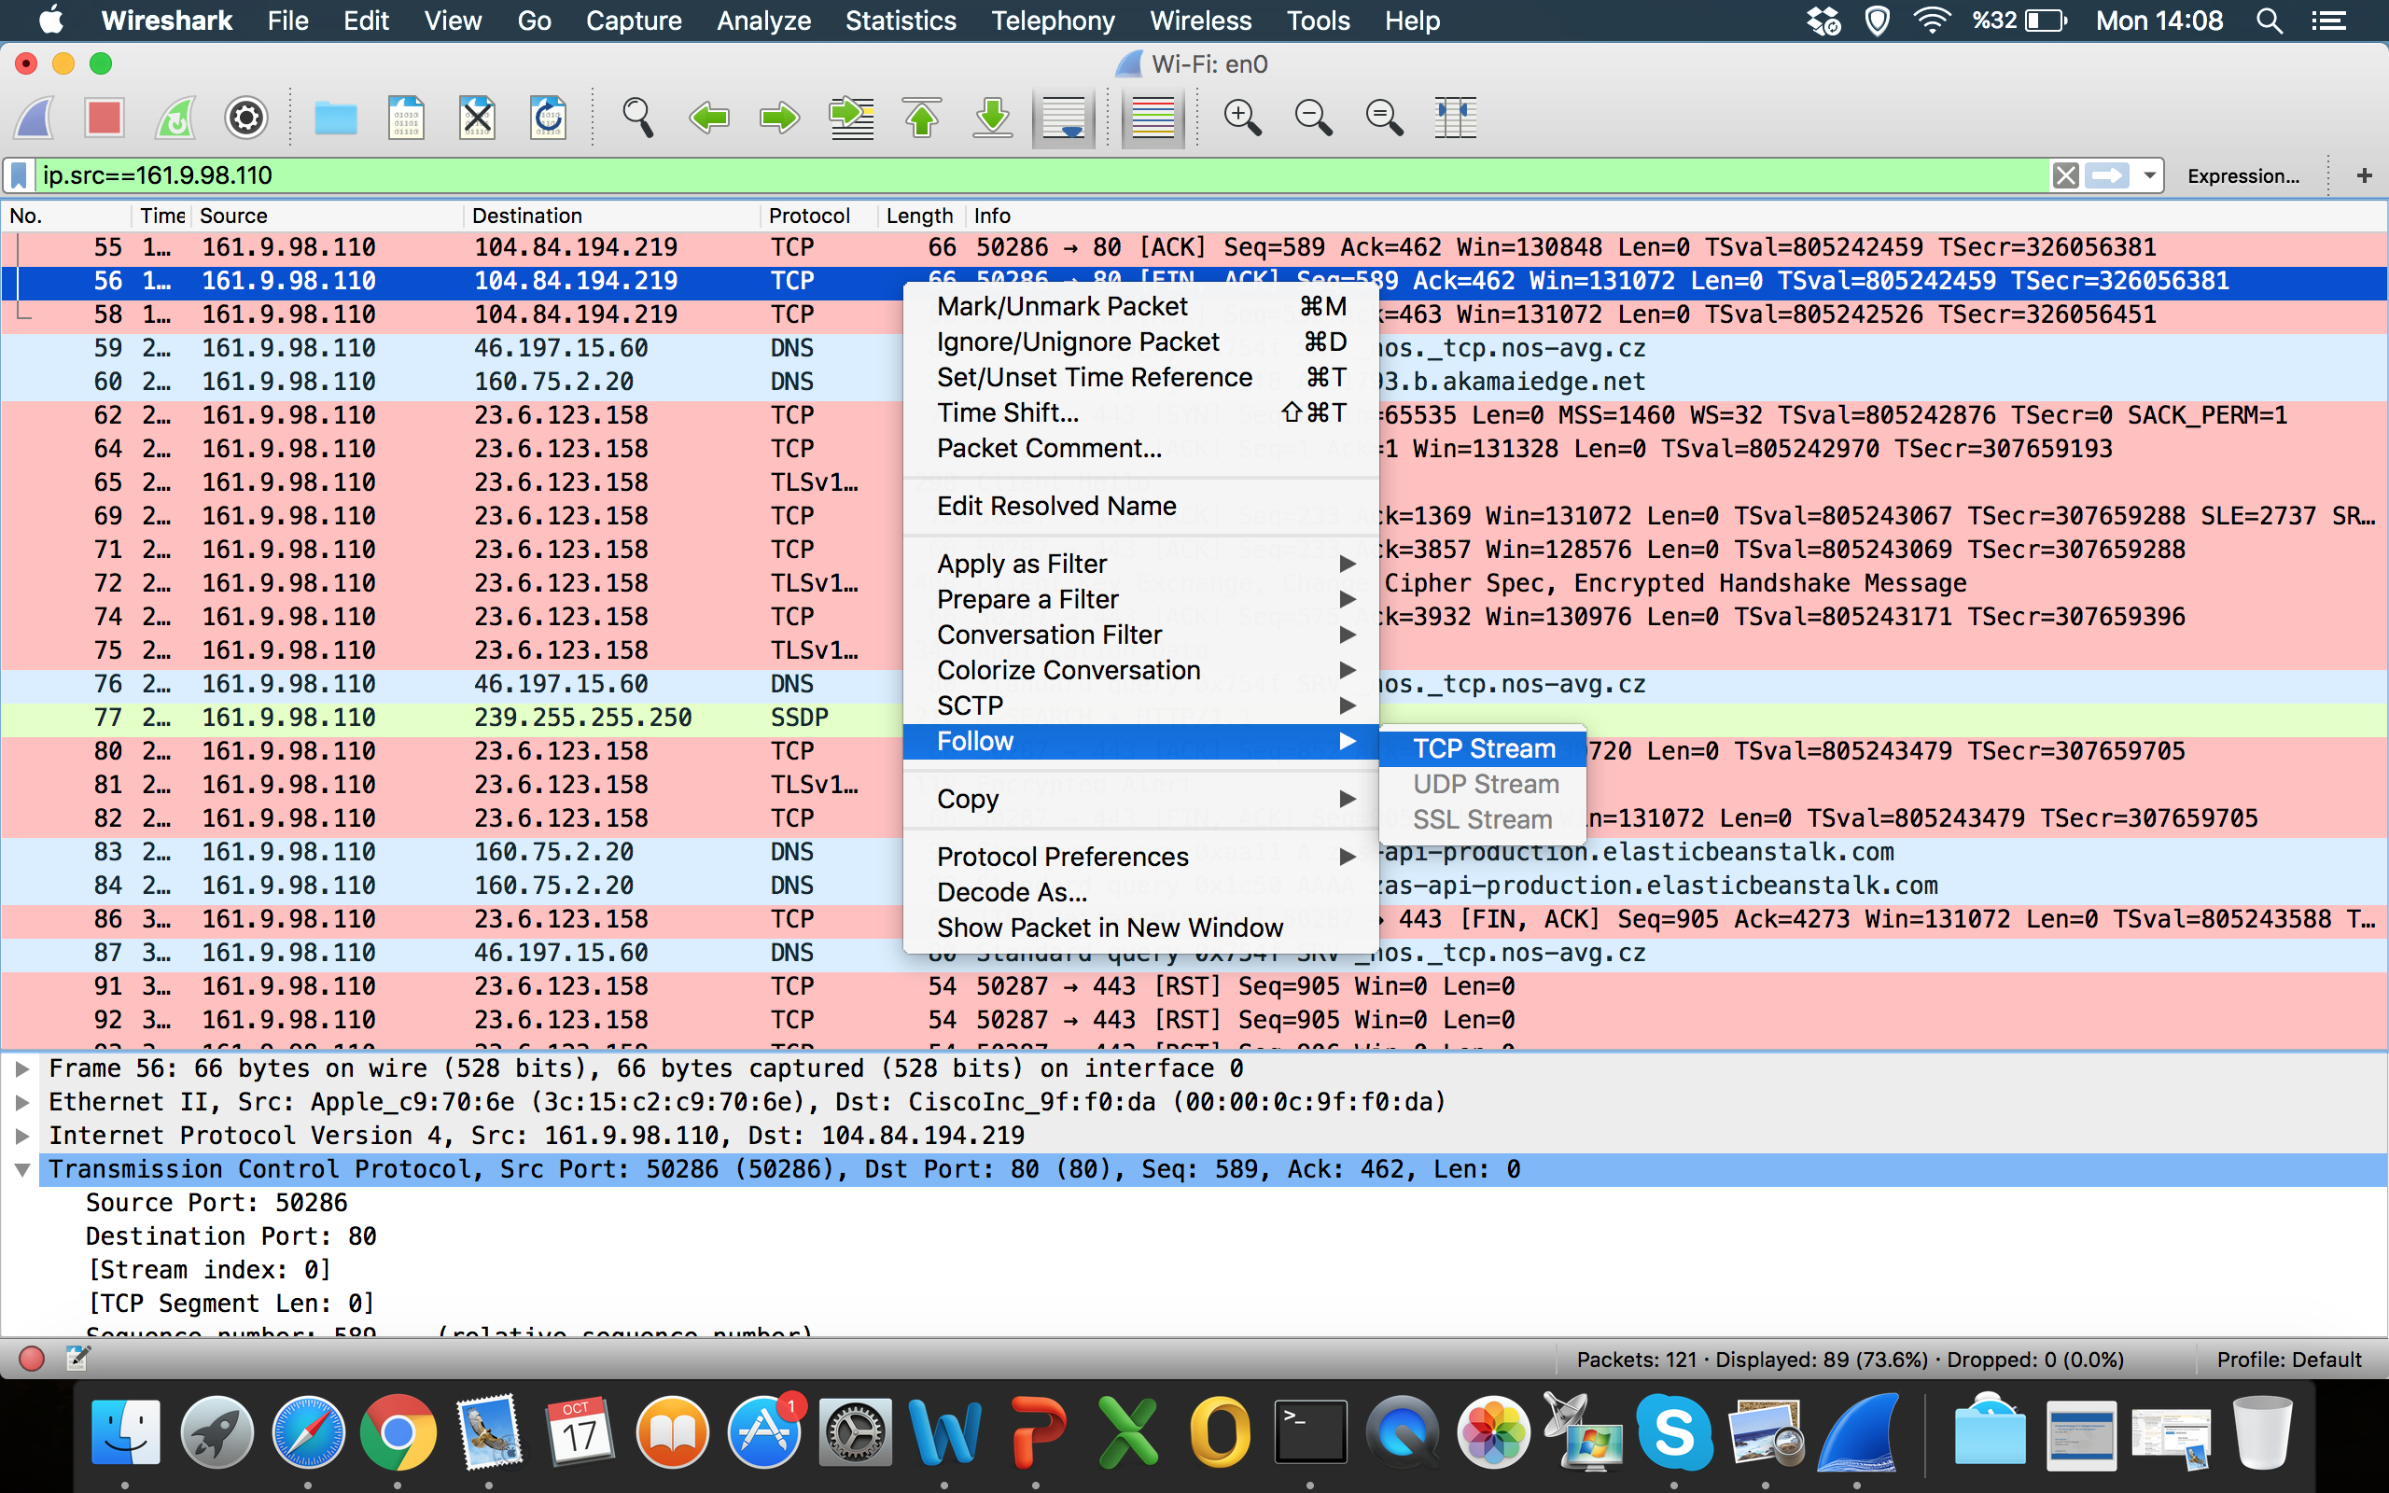
TRAFFIC MONITORING
Notes:
Follow TCP stream

Slide 15
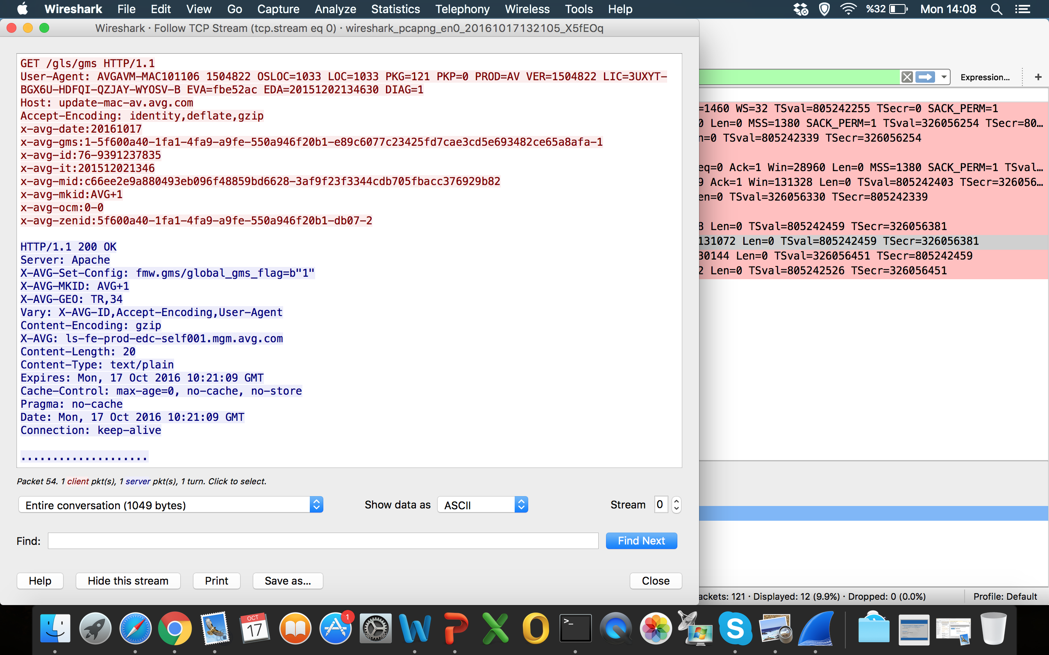
TRAFFIC MONITORING
Notes:
Follow TCP stream

Slide 16
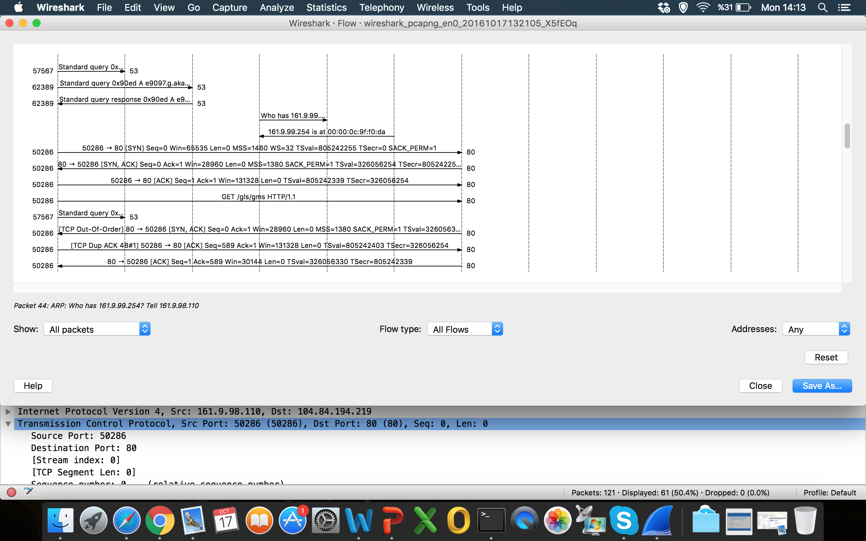
TRAFFIC MONITORING
Notes:
Flow graph

Slide 17
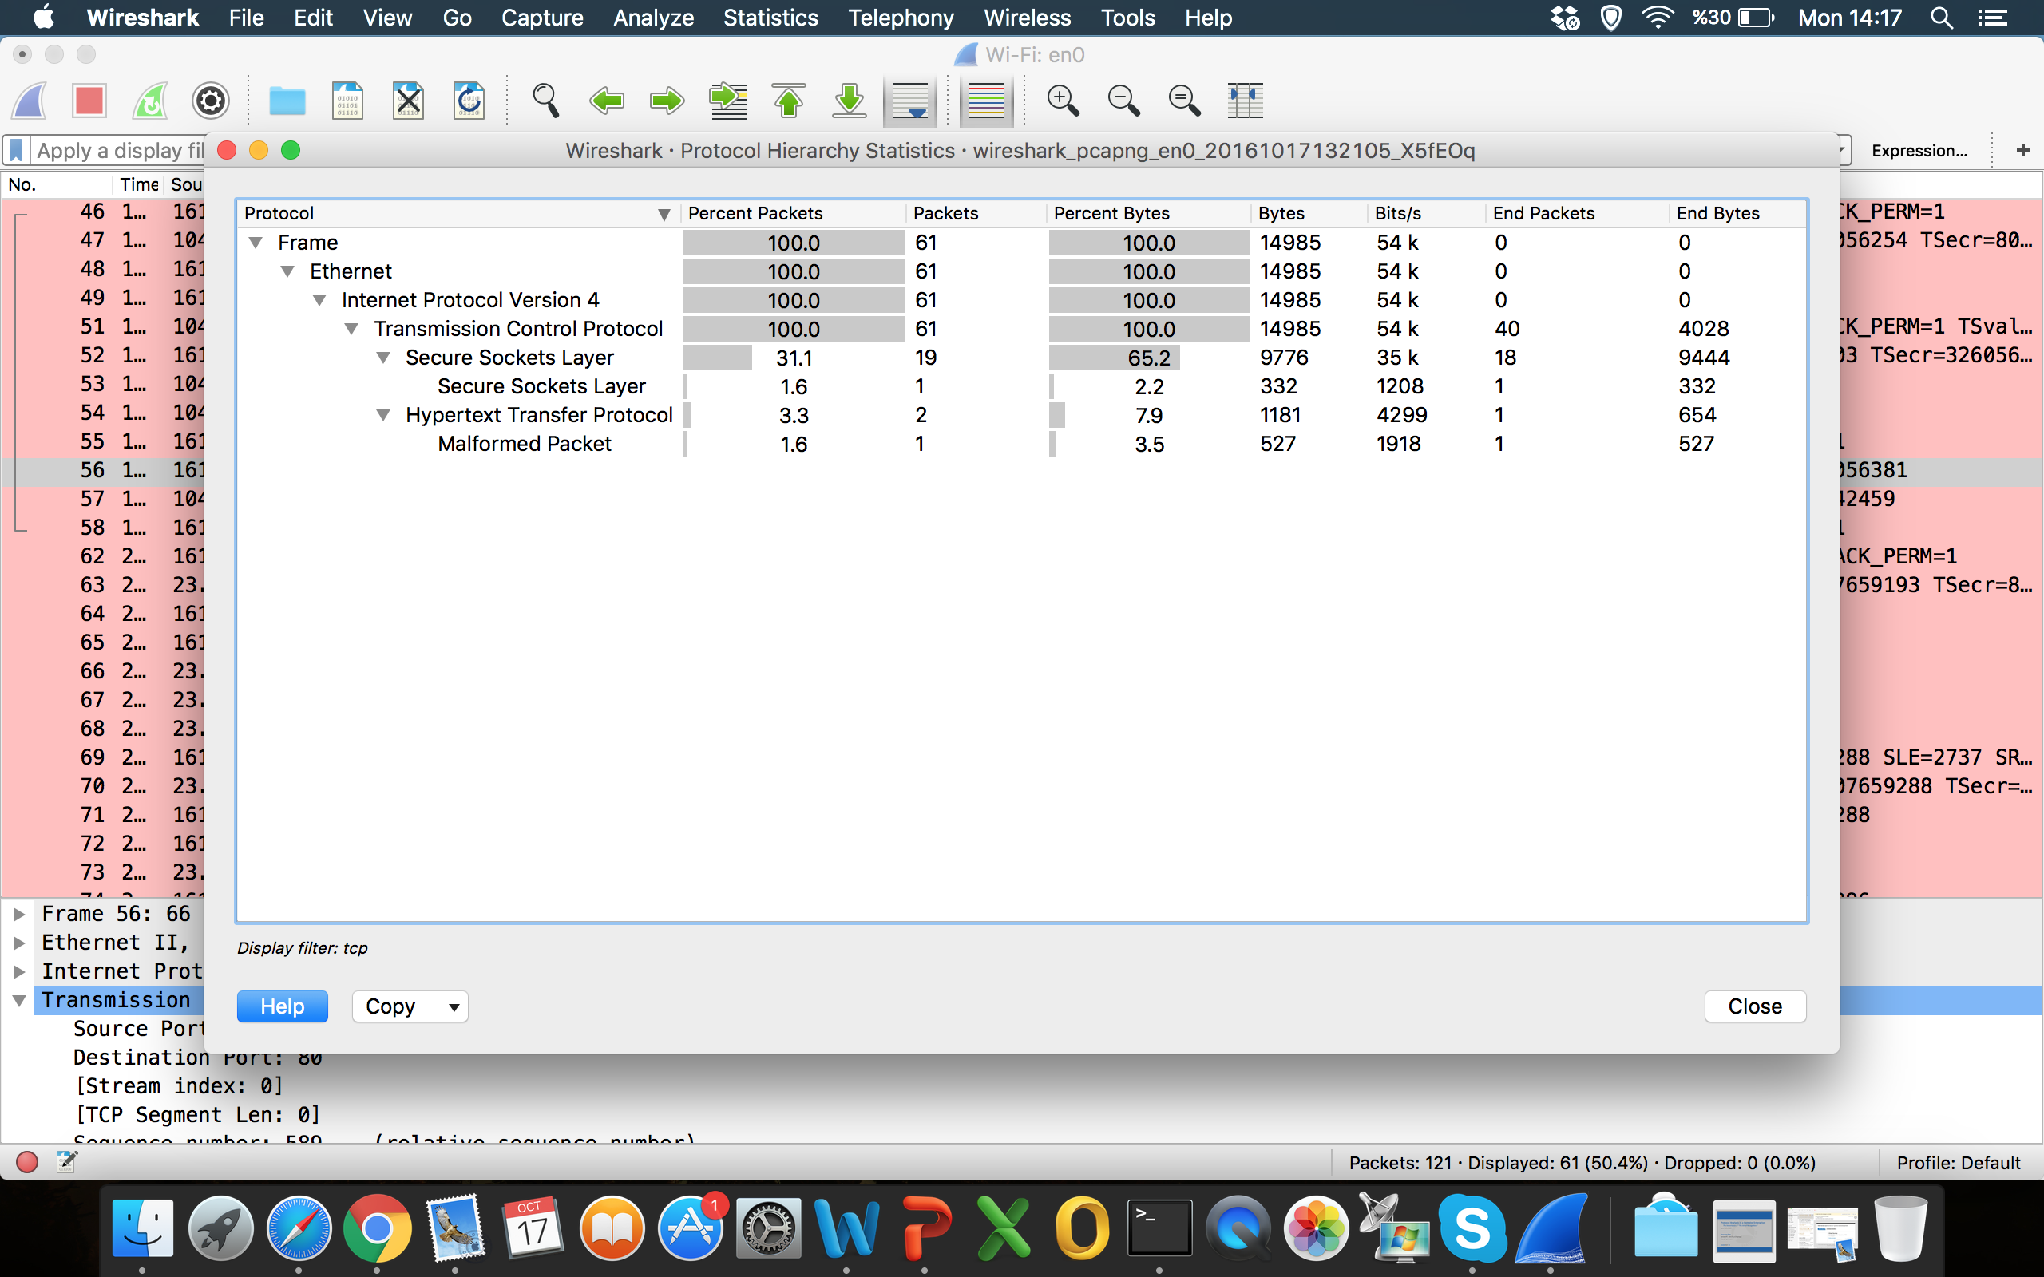
TRAFFIC MONITORING
Notes:
Protocol hierarchy statistics

Slide 18
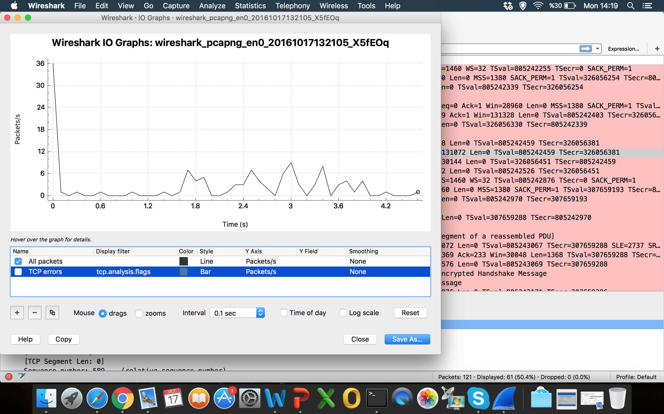
TRAFFIC MONITORING
Notes:
I/O Graph

Slide 19
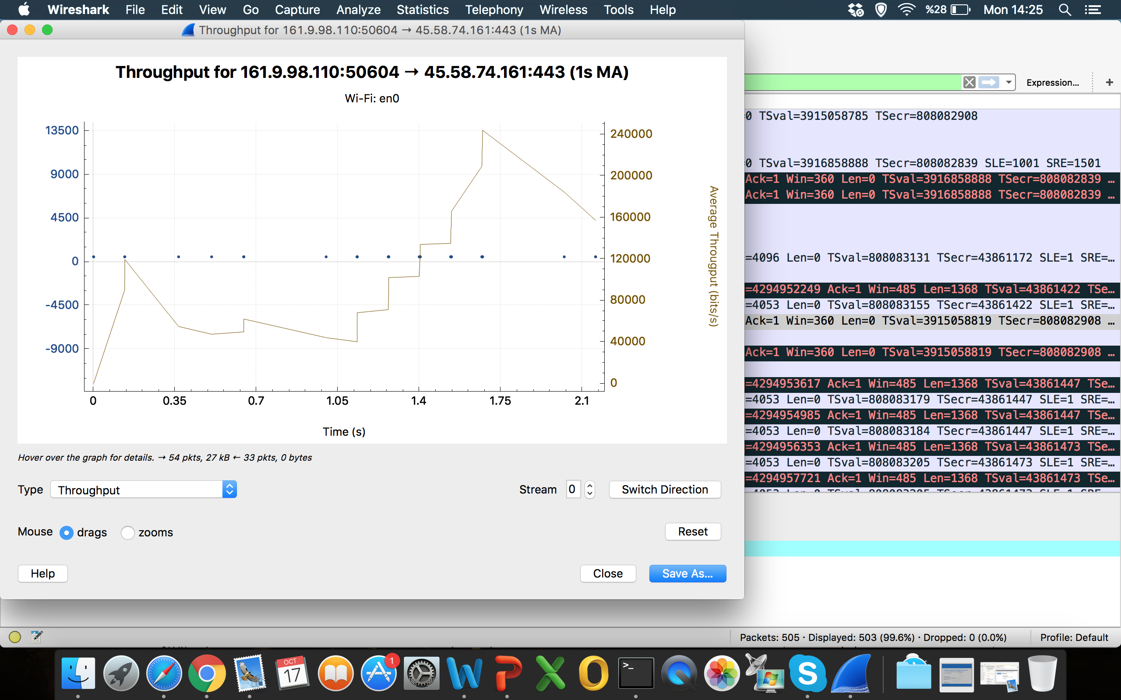
TRAFFIC MONITORING
Notes:
Statistics->TCPStream->
RTT
Throughput

